Slide 1
Importance of Predictive Analysis in Business Intelligence
Prashanth. S (19MID0020)

Slide 2

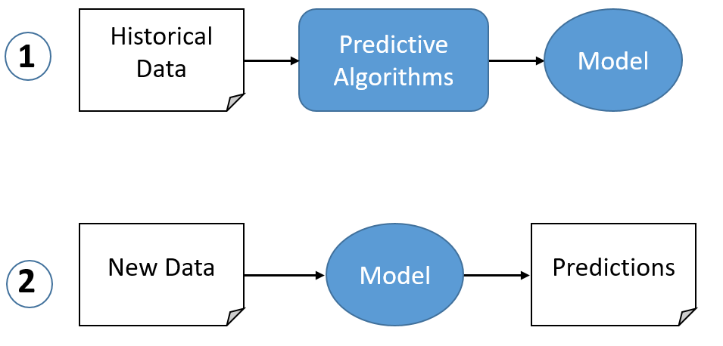
What is predictive analysis ???
The term "predictive analytics" refers to the use of historical data, machine learning, and artificial intelligence to forecast future events.
This historical data is loaded into a mathematical model that takes into account the data's important trends and patterns.
The model is then used to anticipate what will happen next using current data.

Slide 3
How these predictive analysis help companies ???
For many companies, predictive analytics is nothing new. But it is increasingly used by various industries to improve everyday business operations and achieve a competitive differentiation.
Using the information from predictive analytics can help companies—and business applications—suggest actions that can affect positive operational changes.
Analysts can use predictive analytics to foresee if a change will help them reduce risks, improve operations, and/or increase revenue.
At its heart, predictive analytics answers the question, “What is most likely to happen based on my current data, and what can I do to change that outcome?”

Slide 4

Real world examples of Predictive Analysis in Business Intelligence ???
Predicting buying behavior
Predicting purchasing behaviour in the retail industry is one of the most common applications of predictive analytics. Companies use the tools to learn everything they can about their clients. Advanced analytics are used by businesses to determine buying trends based on previous purchase history.
Walmart is a good illustration of this. It made advantage of early data to figure out how people buy in certain situations. Predictive analytics can be used by small ecommerce shops to forecast client buying habits. It aids in gaining a better understanding of clients on a more intimate level.

Slide 5



Fraud Detection
Predictive analytics examples abound as cybersecurity becomes more of a worry. The most crucial is the detection of fraud. To determine dangers, these models can discover anomalies in the system and detect unexpected activity.
Experts can, for example, supply past data on cyberattacks and system dangers. When the predictive analytics programme detects something similar, it will notify the appropriate staff. It will prevent hackers and weaknesses from gaining access to the system.
Card abandonment
This application of predictive analytics is extremely popular among retailers. Cart abandonment is a major problem. Models, on the other hand, can anticipate how likely a client is to abandon the basket based on previous behavior.
By entering the data into a model of purchases made and cart abandonment, for example, the model can forecast how many customers will abandon the cart. It will also give businesses information on each customer's likelihood of purchasing or abandoning a cart based on previous visits to the store.

Slide 6
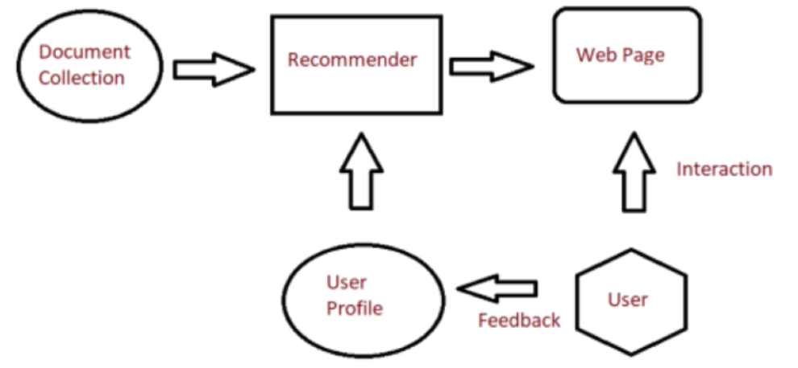
Content Recommendation
Content recommendation is one of the most relatable and obvious predictive analytics examples. Entertainment firms can forecast what customers want to watch based on their past viewing habits using algorithms and models.
"What firms utilize predictive analytics?" You might wonder. Netflix is the most pertinent response. Predictive algorithms are used by the entertainment firm to recommend material to customers based on genre, keywords, ratings, and other factors.
Improvising Customer Service
Advanced analytics and business intelligence can help companies better estimate demand. Consider a hotel chain that wants to know how many people will be staying in a specific location this weekend so that it can make sure it has enough employees and resources to meet demand.

Slide 7
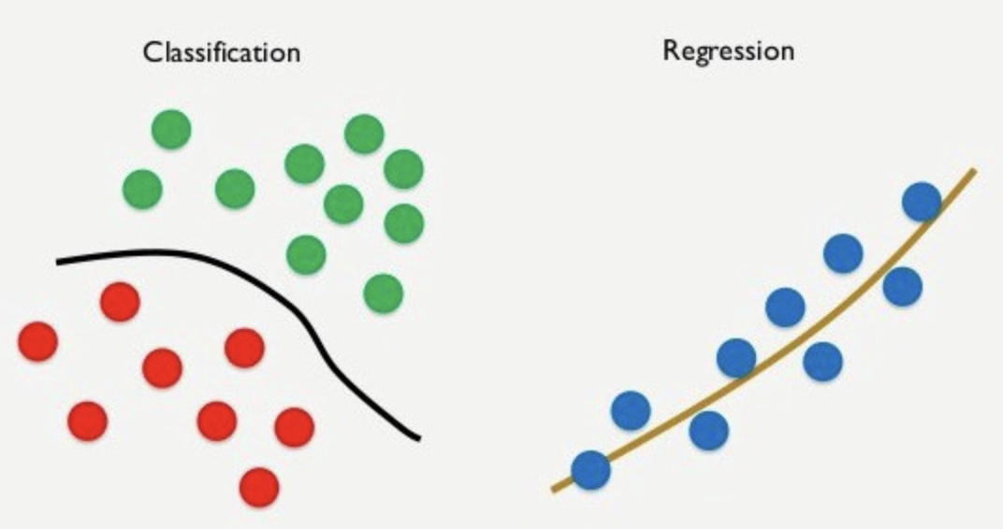
Algorithms used in Predictive Analysis
Linear Regression
Linear regression is a supervised learning machine learning algorithm. It carries out a regression task. Based on independent variables, regression models a goal prediction value. It is mostly utilized in forecasting and determining the link between variables. Different regression models differ in terms of the type of relationship they evaluate between dependent and independent variables, as well as the amount of independent variables they employ.
Classification
Classification is the process of dividing a set of data into categories. It can be done on both structured and unstructured data. Predicting the class of provided data points is the first step in the procedure. Target, label, and categories are all terms used to describe the classes.
The task of approximating the mapping function from discrete input variables to discrete output variables is classified predictive modelling. The basic goal is to figure out which category or class the new data belongs to.

Slide 8
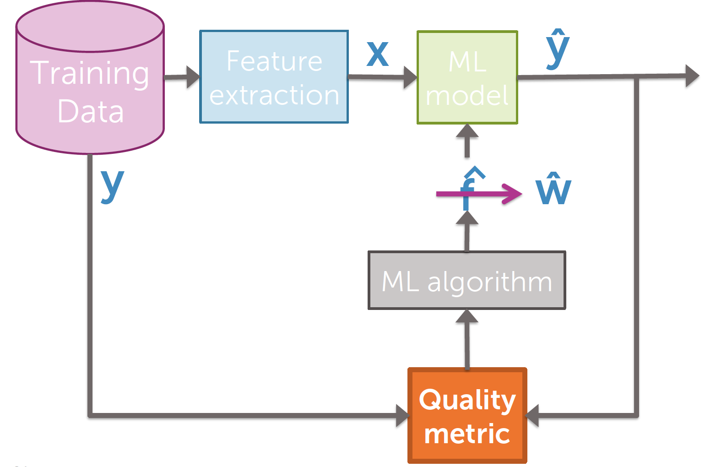
Algorithm work flow
Entire data is divided into training and testing data.
From the training data, selective features are extracted (x) and fed into the model.
ML algorithm like regression, gradient descent generates optimized coefficients (w^).
These coefficients are applied on the training data and predicts the output (y^)

Slide 9
Difference between Machine Learning Algorithm and Machine Learning Model
What is an algorithm in machine learning ??
An “algorithm” in machine learning is a procedure that is run on data to create a machine learning “model.”
Machine learning algorithms perform “pattern recognition.” Algorithms “learn” from data, or are “fit” on a dataset.
Academics can devise entirely new machine learning algorithms and machine learning practitioners can use standard machine learning algorithms on their projects.
This is just like other areas of computer science where academics can devise entirely new sorting algorithms, and programmers can use the standard sorting algorithms in their applications.
We have algorithms for Regression like Linear Regression, Multiple Linear Regression, Polynomial Regression. Classification like Naïve Bayes, K-Nearest Neighbour, Logistic Regression, Decision Tree. Clustering like K-Means Clustering, Hierarchical Clustering.

Slide 10
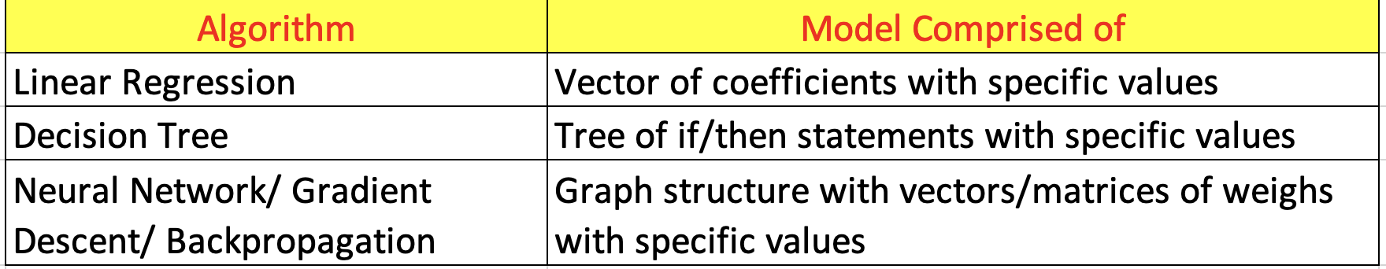
What is a model in machine learning ??
A “model” in machine learning is the output of a machine learning algorithm run on data.
A model represents what was learned by a machine learning algorithm.
The model is the “thing” that is saved after running a machine learning algorithm on training data and represents the rules, numbers, and any other algorithm-specific data structures required to make predictions.
The machine learning model “program” is comprised of both data and a procedure for using the data to make a prediction.
Machine learning model → model data + prediction algorithm

Slide 11
Machine Learning is automatic Programming
Eg: Classifying the mail as spam and not spam.
Traditional Approach:
Developing a software by manually reviewing a ton of mails, by writing if-else statements to perform this task. But this is an extremely slow, fragile and not very effective.
ML Approach:
In-stead, we can use machine learning techniques to solve this problem. Specifically, an algorithm like naïve bayes can learn how to classify email messages as spam and not spam from a large dataset of historical examples of email.
But We don’t want “naive bayes.” We want the model that naive bayes gives is that we can use to classify email (the vectors of probabilities and prediction algorithm for using them). We want the model, not the algorithm used to create the model.

Slide 12
Final Thoughts of ML algorithm and ML model
As developers, we are less interested in the “learning” performed by machine learning algorithms in the artificial intelligence sense. We don’t care about simulating learning processes.
Instead, we are more interested in the automatic programming capability offered by machine learning algorithms. We want an effective model created efficiently that we can incorporate into our software project.
“Machine learning algorithms perform automatic programming. Machine learning models are the programs created for us.”

Slide 13
Conclusions
Business intelligence refers to the technology, processes, and procedures that businesses and their customers use to acquire, integrate, analyze, and present data. BI technologies, unlike traditional data analytics tools, offer information in a more logical manner.
Businesses can use detailed insights from bi systems to help them make decisions about sales, marketing, product development, customer support, and more.
Although typical bi tools are designed to provide insights into past interactions or current events, predictive analytics—which uses historical data, statistical algorithms, and machine learning—can provide businesses with a glimpse into the future.
This is accomplished through spotting opportunities and allowing organizations to be flexible and proactive in their response to future developments.

